Slide 1
Miniaturized Graphic Engine
Digital Systems Design with FPGA (Prof. Debayan Das)
Hemanth Raj (23120)
Kishan Baranwal (23483)
Kushal Gowda (22445)
Rahul Kumar (23773)

Slide 2
Contents
Aim
VGA controller
Animation
Rotation
Bresenham's algorithm
Background formation
Full screen text editor

Slide 3

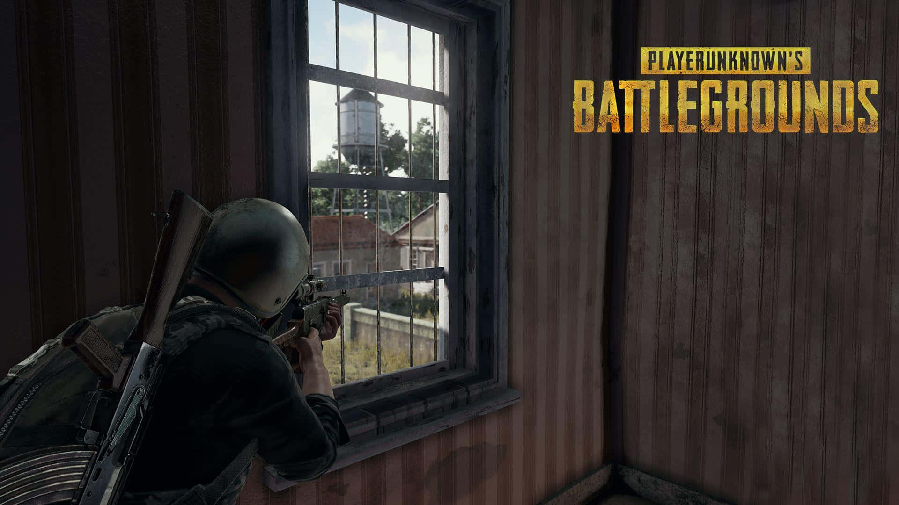



Background accelerator
Miniaturized Graphic Engine
Aim
All rooms will have same background with only extra objects and wall colors.
2. Animation
Animation shows basic law of reflection and translated object.
3. Rotation and line formation
Using sin cos matrix approximation rotation
4. Full Screen Text display
Displays text on Full Screen
Source: Google image

Slide 4
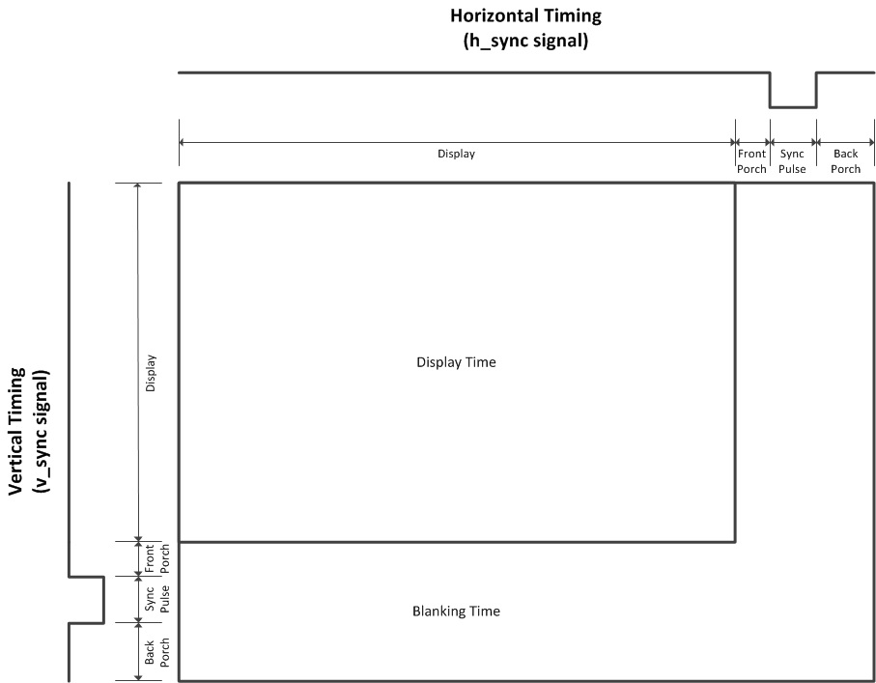
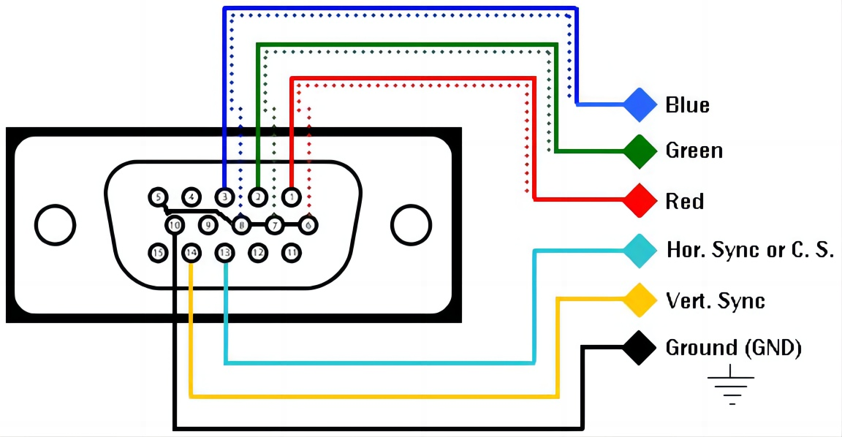
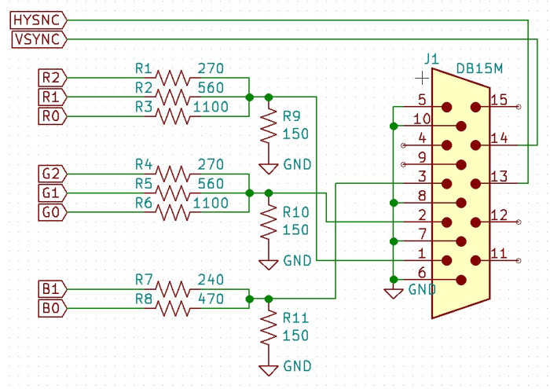
VGA Controller
Miniaturized Graphic Engine
VGA RED : red color channel
VGA GREEN : green color channel
VGA BLUE : blue color channel
VGA HSYNC : Tells when horizontal screen has been completed
VGA VSYNC : Tells when all horizontal lines are completed
FRONT PORCH and BACK PORCH are safety timing for circuitry to have time to move beam. In between image can not be generated.
Reference Book: Chu, Pong P. Wiley, 2008 "FPGA Prototyping by Verilog Examples: Xilinx Spartan-3 Version"

Slide 5
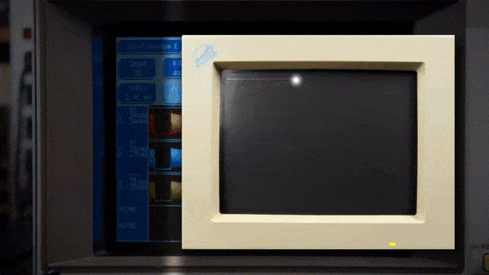
640 * 480 pixels
25 MHz each pixel update
Updating frame without flickering at 60 Hz

Slide 6
Object Animation
Object Animation
Changing objects location from frame to frame creates an illusion of motion
The screen is redrawn 60 times per second as the monitor supports 60Hz refresh rate.
Each time, the object is moved by a small amount (move by less number of pixels) making it feel like the object is moving.
Registers are used to track X and Y coordinates of the object.
Four registers are used to track right, left, top and bottom edges of the square
For each frame, registers are incremented or decremented based on the direction of motion.

Slide 7
Object Animation
Object Animation
If the object is incremented in both right and down directions, it moves diagonally downwards.
Upon collision with the bottom of the screen, the Y value flips and starts decrementing while X keeps incrementing until it hits the right most edge of the screen
Upon collision with the right most edge of the screen, the X value also flips and starts decrementing and the motion will be as shown.

Slide 8
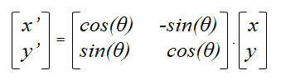
Matrix Rotation using approximation
Miniaturized Graphic Engine
Rotation matrix is transformation matrix in linear algebra that is used to perform rotation in Euclidean space.
Rotation matrix:
Verilog code for rotating the point after every 15 degree :
x_pt – (x_pt>>>5) = x(1 - 1/32) = x(0.968) , which is approximately equal to cos(15)= 0.967.
(y_pt>>>2) + (y_pt>>>7) = y(1/4 + 1/128) = y(0.2578) , which is approximately equal to
sin(15)= 0.2588.
The changed cordinated are fed again to x_pt and y_pt to rotate continuously for 15 degree .

Slide 9
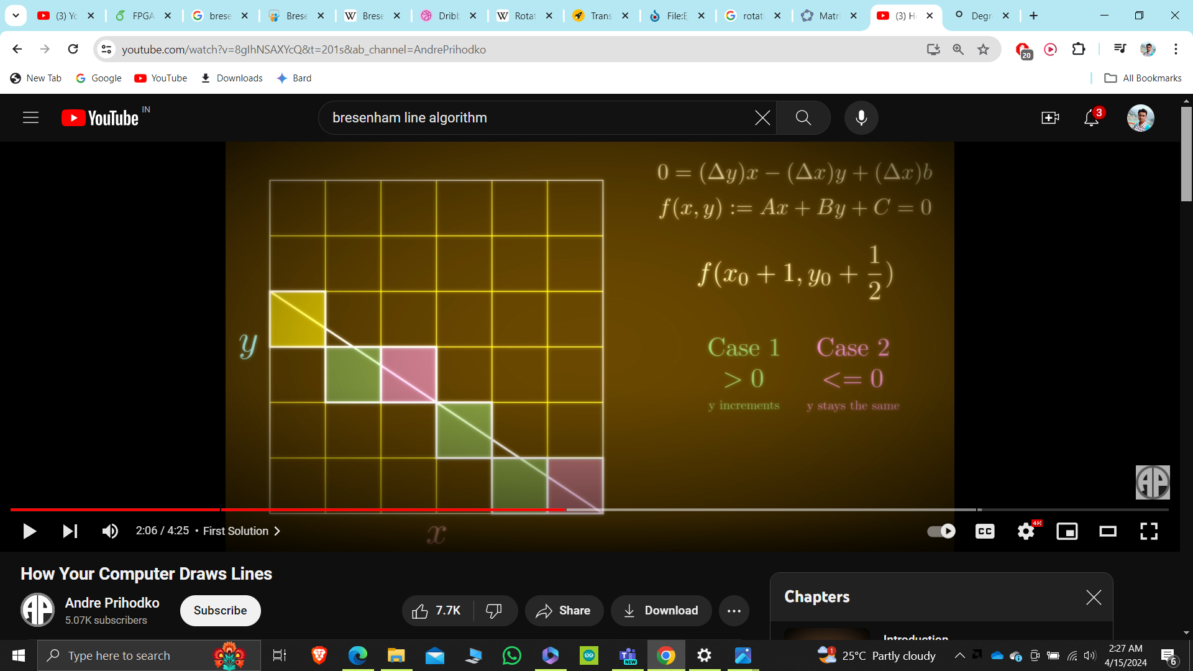
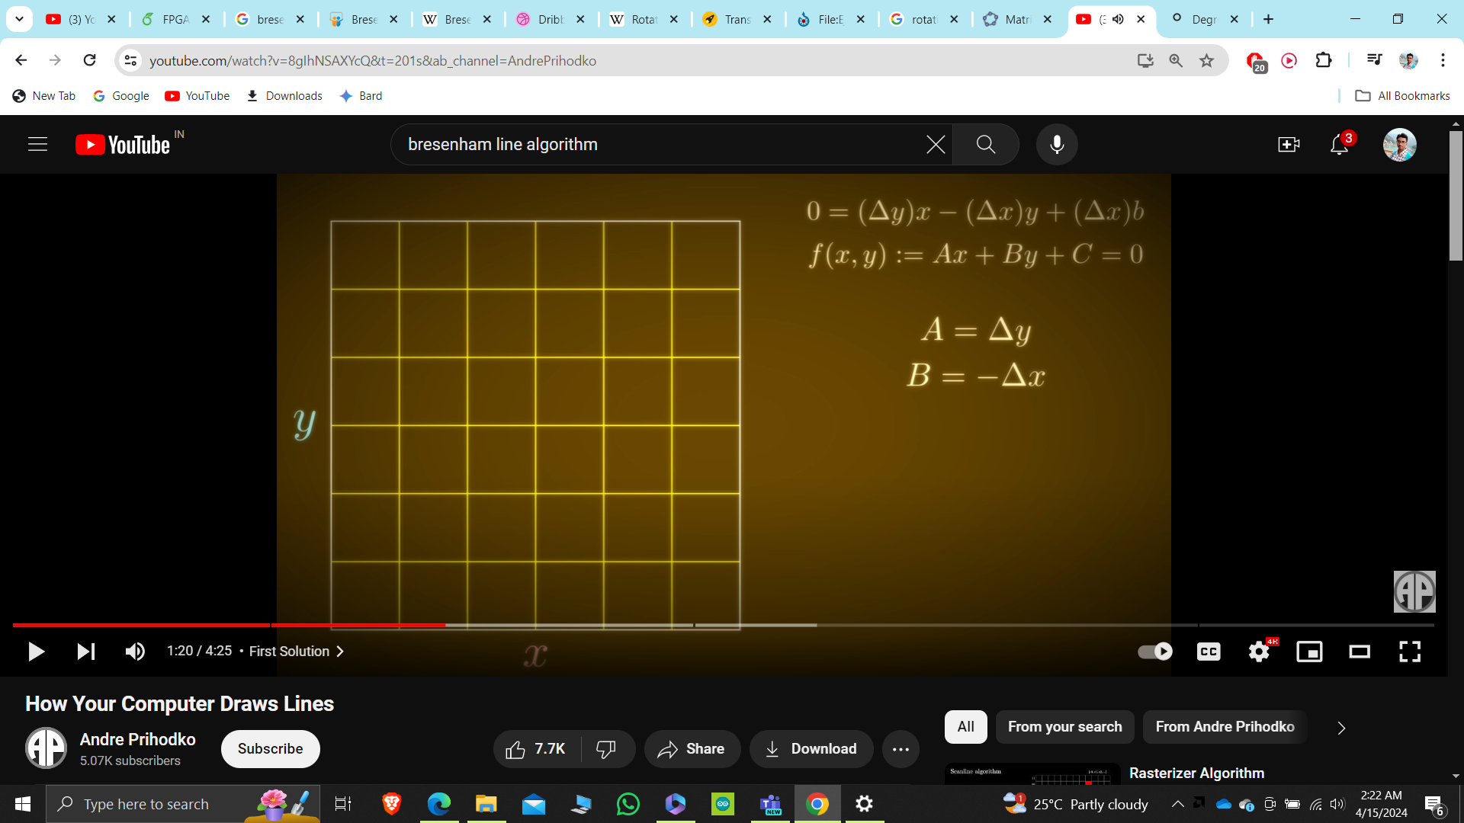
Bresenham's Line Algorithm:-
Miniaturized Graphic Engine
Bresenham's line algorithm is a line drawing algorithm that determined all the points in a plane that should be selected in order to form a close appoximation to a straight line between two points.
Consider line Y= mX + C , slope (m) is ΔY/ΔX, the equation will become : (for m <1)

Slide 10
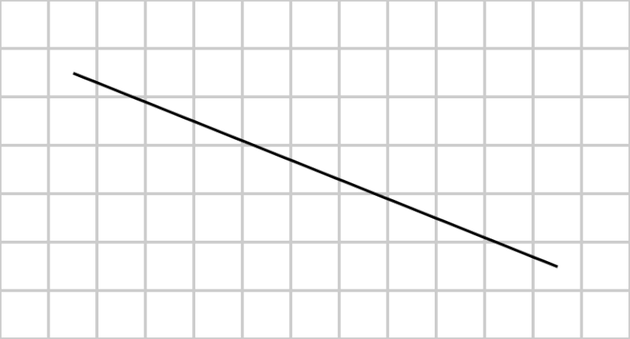
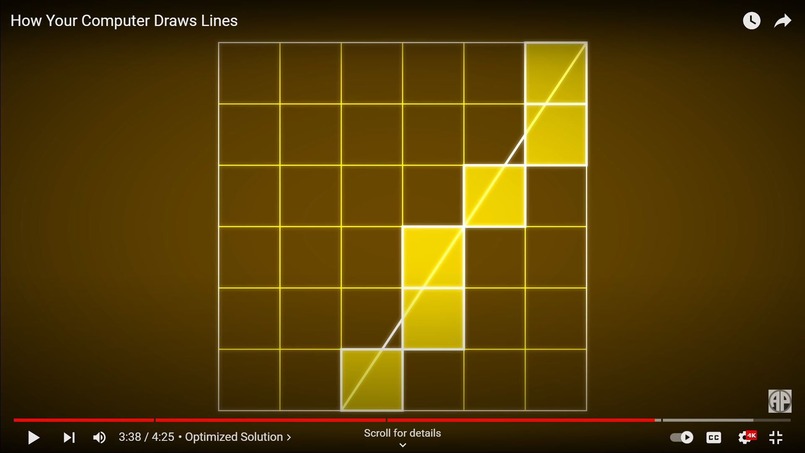
Bresenham's Line Algorithm:-
Line Drawing
Now the incremented y and x is chacked again in line equation F(x0 , yo+½), to find whether the new point is above the line or below the line.
Similarly for m >1, Y =Y+1; and X need to check for line positon,
For m<0, complete algorithm follows with slope=(- Δy /Δ x).
x
(x1,y1)
(x2,y2)
y
Slope(m) = -ve
Tracing of line b/w two point using Bresenham's algo.

Slide 11
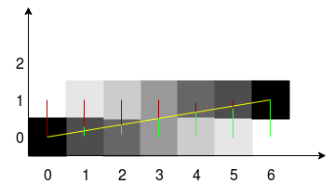
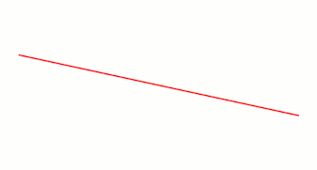
Limitations
Bresenham's algorithm do not plot static line.
Bresenham's algorithm is not capable of plotting steep line.
Future Modifications
Bresenham's line algorithm should be replaced with Xiaolin Wu's line algorithm to get static and steep line for all slope.
So static cube formation with rotation can easily be formed.
Xiaolin emphasized the significance of pixel intensity when illuminating pixels while plotting lines.
Intensity of pixel
Xiaolin Wu's line algorithm

Slide 12
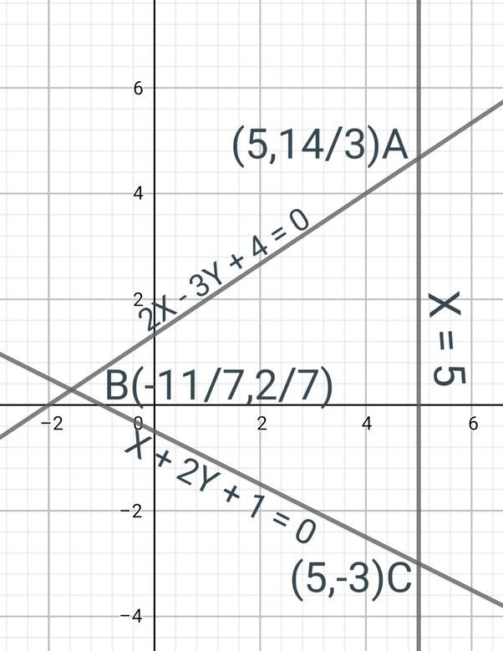
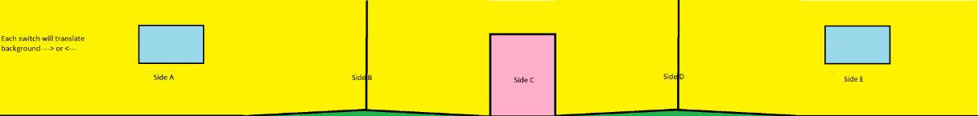
Formation of dots
Background Motion
assign dot0 = ((x_pt >= (x_out_pt0_coordinate - 1)) && (x_pt < (x_out_pt0_coordinate + 1)) && (y_pt >= (y_out_pt0_coordinate - 1)) && (y_pt < (y_out_pt0_coordinate + 1)));
Formation of rectangle
assign dot0 = ((x_pt >= (x_out_pt0_coordinate - W)) && (x_pt < (x_out_pt0_coordinate + W)) && (y_pt >= (y_out_pt0_coordinate - L)) && (y_pt < (y_out_pt0_coordinate + L)));
Formation of line of fixed slope
if((y0_new < y1) && video_on && (x == x0_new) && (y == y0_new))
y0_new <= y0_new + dx;
if((x0_new < x1) && video_on &&(x == x0_new) && (y == y0_new))
x0_new <= x0_new + dy;
Formation of triangle
assign dots = (x_pt < line1_x) && (y_pt <line1_y) && (x_pt < line2_x) && (y_pt <line2_y) && (x_pt > line3_x) && (y_pt >line3_y)
Lateral shift of each point
x_out_pt0_coordinate <= x_out_pt0_coordinate – dx;
y_out_pt0_coordinate <= y_out_pt0_coordinate – dy;

Slide 13
Full Screen Text Editor
Miniaturized Graphic Engine
pixel x
Controller
ASCII ROM
pixel y
sw[6:0]
addr[11:0]
data[7:0]
Pixel Output
set
text_bit
up
Cursor Position
down
{x,y}
left
right
bit_addr[2:0]

Slide 14
ASCII ROM
Each ASCII character takes 8*16 space on screen, so 8*16 bits of ROM has to be set for each character
Hence, for all 128 ASCII characters we need 128*8*16 = 16384 bits of ROM
Thus, a total of 2048 bytes are required, that requires 11 bits of address.
The 7-bit ASCII code for each character is used as the MSB of the address.
The 4-bit LSB is the row value.
code x21 (!)
11'h210: data = 8'b00000000;
11'h211: data = 8'b00000000;
11'h212: data = 8'b00000000;
11'h213: data = 8'b00011000;
11'h214: data = 8'b00011000;
11'h215: data = 8'b00011000;
11'h216: data = 8'b00011000;
11'h217: data = 8'b00011000;
11'h218: data = 8'b00011000;
11'h219: data = 8'b00000000;
11'h21a: data = 8'b00011000;
11'h21b: data = 8'b00011000;
11'h21c: data = 8'b00000000;
11'h21d: data = 8'b00000000;
11'h21e: data = 8'b00000000;
11'h21f: data = 8'b00000000;
// code x35 (5)
11'h350: data = 8'b00000000;
11'h351: data = 8'b00000000;
11'h352: data = 8'b11111110;
11'h353: data = 8'b11111110;
11'h354: data = 8'b11000000;
11'h355: data = 8'b11000000;
11'h356: data = 8'b11111110;
11'h357: data = 8'b11111110;
11'h358: data = 8'b00000110;
11'h359: data = 8'b00000110;
11'h35a: data = 8'b11111110;
11'h35b: data = 8'b11111110;
11'h35c: data = 8'b00000000;
11'h35d: data = 8'b00000000;
11'h35e: data = 8'b00000000;
11'h35f: data = 8'b00000000;
// code x41 (A)
11'h410: data = 8'b00000000;
11'h411: data = 8'b00000000;
11'h412: data = 8'b00010000;
11'h413: data = 8'b00111000;
11'h414: data = 8'b01101100;
11'h415: data = 8'b11000110;
11'h416: data = 8'b11000110;
11'h417: data = 8'b11111110;
11'h418: data = 8'b11111110;
11'h419: data = 8'b11000110;
11'h41a: data = 8'b11000110;
11'h41b: data = 8'b11000110;
11'h41c: data = 8'b00000000;
11'h41d: data = 8'b00000000;
11'h41e: data = 8'b00000000;
11'h41f: data = 8'b00000000;

Slide 15
Thank You

